Slide 1
Machine Learning ~ Predicting Diabetes
Group 1: Sapir Madar Coulson, Ana Garcia, Daniel Grimm, Maha Pentakota & Michael Villeada
Notes:
Ana

Slide 2


Project
Overview
We use machine learning to predict if a patient has either diabetes, pre-diabetes, or no diabetes.
Our Diabetes Risk Predictor based on our model will determine if the subject has a high, low, or no risk of diabetes with an accuracy of 84%.
Notes:
ANA

Slide 3

Data Sources
The datasets are publicly accessible provided by the Behavioral Risk Factors Surveillance System (BRFSS) conducted by the Center for Disease Control and Prevention (CDC)
diabetes_012_health_indicators_BRFSS2015.csv is a clean dataset of 253,680 survey responses to the CDC's BRFSS 2015.
The target variable Diabetes_012 has 3 classes:
0 is for no diabetes or only during pregnancy
1 is for prediabetes
2 is for diabetes.
Notes:
ANA

Slide 4
Machine Learning Process
Contributing Factors of Diabetes that are used in our model:
History of Stroke
History of Heart Disease or Heart Attack
Active Physical Lifestyle
General Health
Sex
Age
Education
Income
No ability to visit doctor due to cost
Mental Health in the last 30 days
Physical Health in the last 30 days
High Blood Pressure
High Cholesterol
Cholesterol Check in the last 5 years
BMI
Difficulty walking
Consumption of Fruits
Consumption of Vegetables
Smoking Habits (Never, Former, Current)
Heavy Drinking
Accessibility to Healthcare/Health Insurance
The following Libraries were used:
Spark
Streamlit
Tableau
Tensorflow/Keras Spark (reading in the dataset and creating
Notes:
Michael

Slide 5
Data Clean Up
Access Dataset
2. Define Parameters
Searched on Kaggle
Found a clean dataset:
The original dataset contains responses from 441,455 individuals and has 330 variables
The dataset we used for the model was tapered to 253,680 individuals and has 21 variables
Smoking History
0 - Never
1 - Former Smoker
2 - Current Smoker
General Health
1 - Excellent
2 - Very Good
3 - Good
4 - Fair
5 - Poor
Age Ranges
1st: 18-24 years
2nd: 25-29 years
3rd: 30-34 years
4th: 35-39 years
5th: 40-44 years
6th: 45-49 years
7th: 50-54 years
8th: 55-59 years
9th: 60-64 years
10th: 65-69 years
11th: 70-74 years
12th: 75-79 years
13th : 80+ years
Notes:
Michael

Slide 6
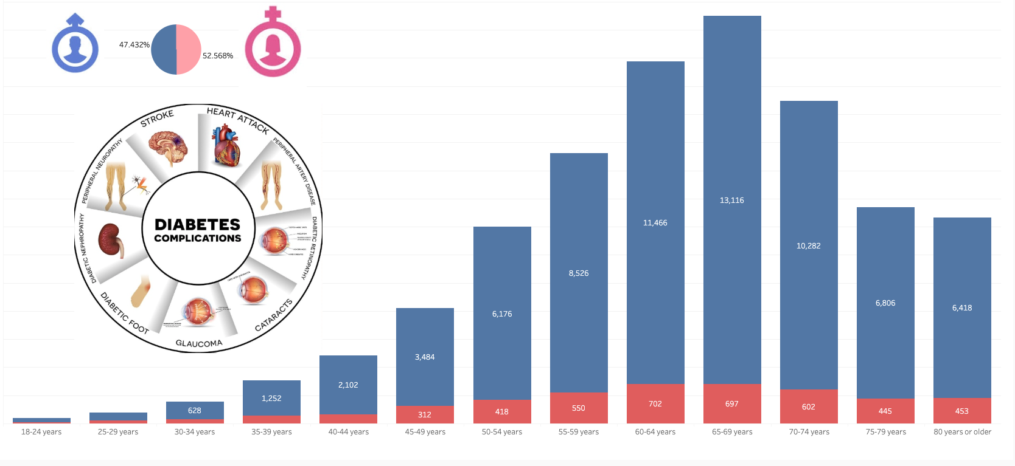
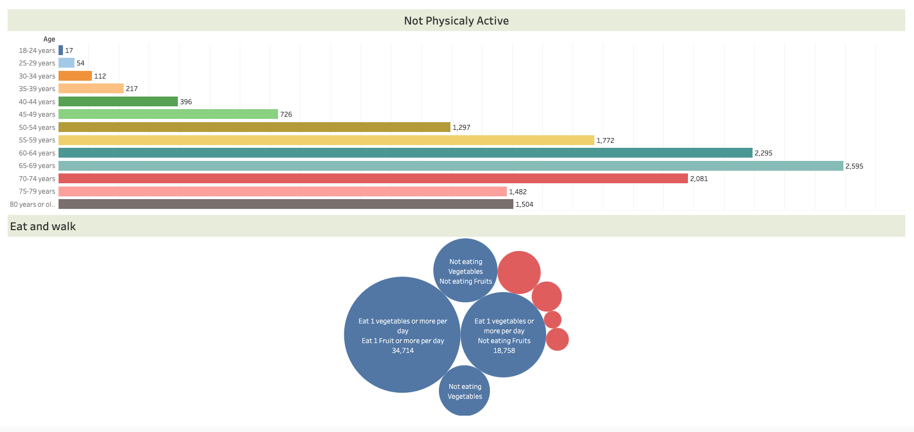
Data Visualization - Model
Fig. 1
Fig. 2
Fig 1 - Pie Chart of Male v Female Percentage of with Diabetes
Bar Graph of age range and count of adults with diabetes and pre-diabetes
Fig 2 - Bar Graph of diabetic and pre-diabetic adults who are not physically active.
Including filters of vegetable and fruit consumption
Notes:
Maha

Slide 7
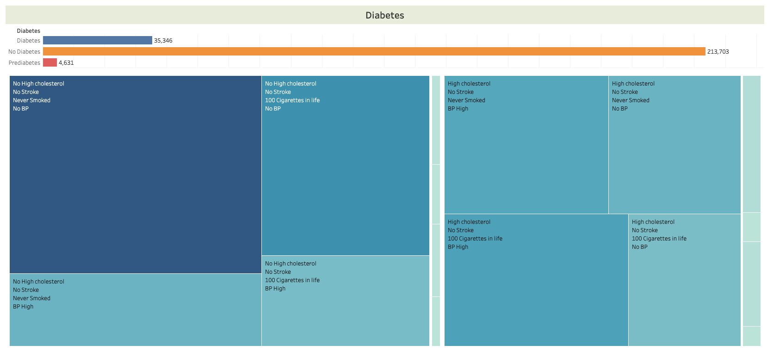
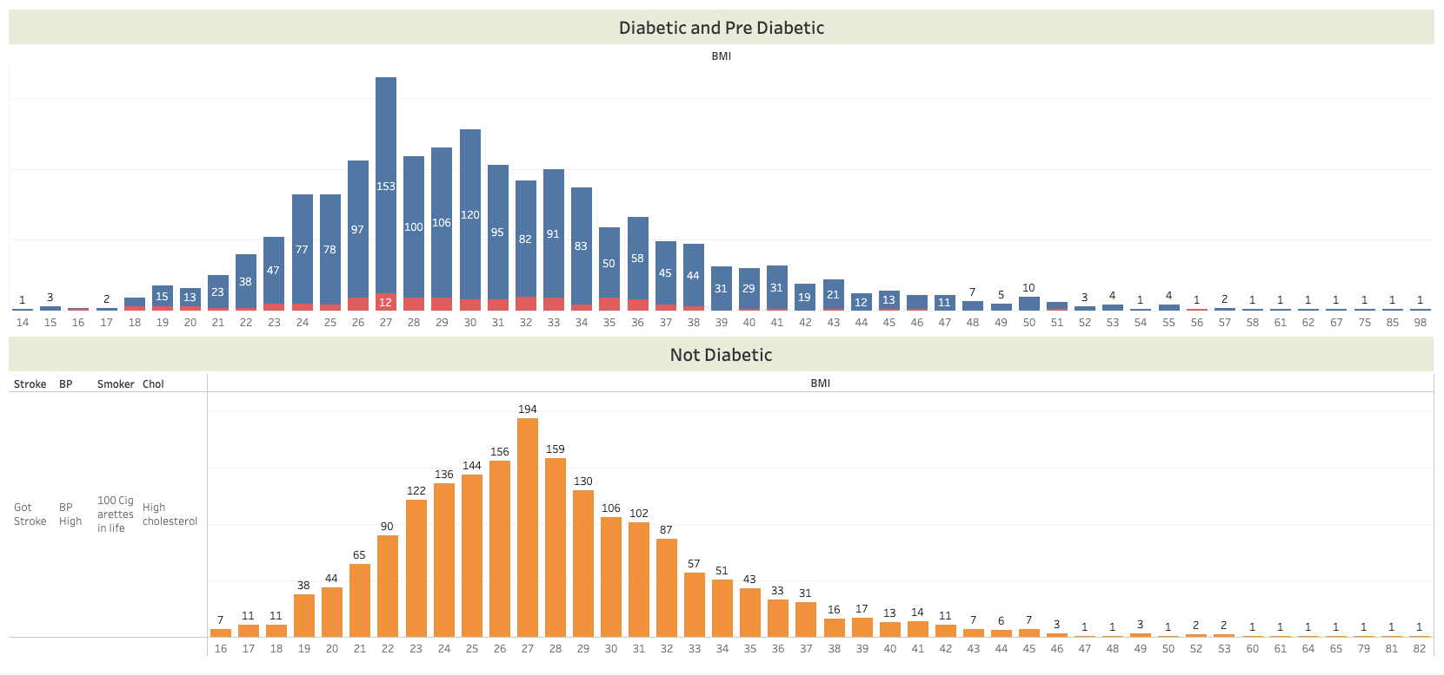
Data Visualization - Model
Fig. 3
Fig. 4
Fig 3 - Count of diabetic, pre-diabetic, and non diabetic adults with heatmap of symptoms such as cholesterol, stroke history, smoking, and blood pressure
Fig 4 - Bar graph of BMI levels and count of adults with diabetes and pre-diabetes
Bar graph of BMI levels and count of individuals without diabetes
Fig 1 - Male v Female Percentage of positive Diabetes
Fig. 2 -
Fig. 3 -
Fig. 4 -
Notes:
Maha

Slide 8

Diabetes Statistics around the World
See the world’s facts and figures of the past 20 years.
Data provided by the International Diabetes Federation
Notes:
Sapir

Slide 9
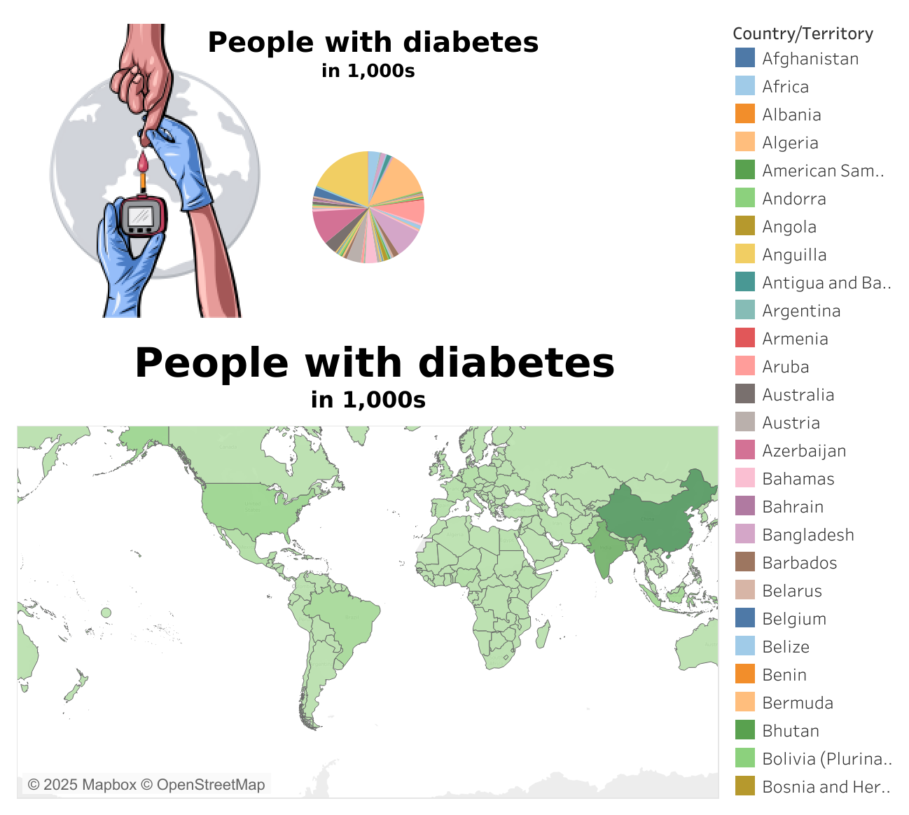
Data Visualization - World Statistic
Figure 5 shows an Interactive World Map. Displaying the total of adults diagnosed with diabetes within each country.
Category A
XX%
Fig. 5
Notes:
Sapir

Slide 10
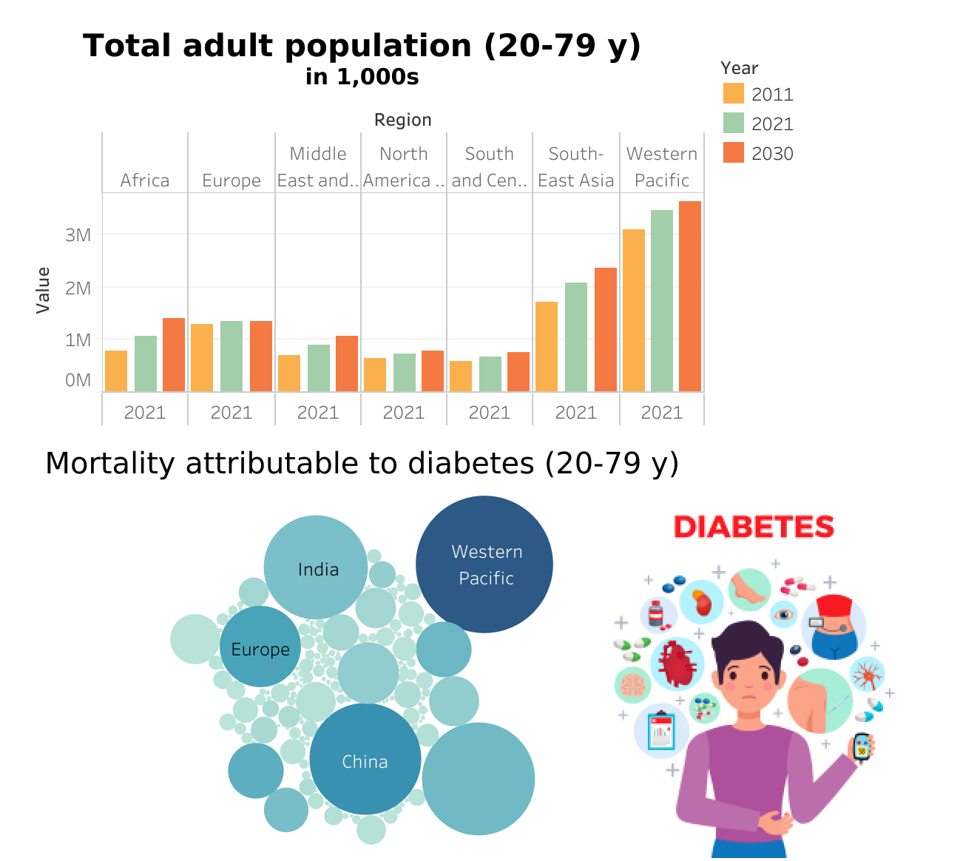
Data Visualization - World Statistic
Figure 6 displays Bar Graphs of the mortality rate attributed to diabetes in the adult population by region and country from the years 2011, 2021, and predicts the model for 2030.
Fig. 6
Notes:
Sapir

Slide 11

Diabetes Prediction Calculator
We created a diabetes risk prediction questionnaire based of the model we trained.
Click the logo on the right to see your likelihood of being diagnosed with diabetes
Notes:
Dan

Slide 12


Final Findings
Further Research
BMI is not a major indicator of diabetes, but definitely can contribute to cardiovascular health issues.
If time permitted, we would have examined how global events, such as economic crises or pandemics, and societal factors like cultural diets and urbanization, impact diabetes trends across countries. By investigating how these external factors interact with health data, we can refine predictive models to better account for the dynamic nature of diabetes trends.
Notes:
Dan

Slide 13
Resources
All of the following data were publicly accessible
https://gis.cdc.gov/grasp/diabetes/diabetesatlas-surveillance.html
https://www.nature.com/articles/s41598-021-90406-0
https://diabetesatlas.org/data/en/
https://www.cdc.gov/diabetes/php/data
https://www.who.int/data/gho/info/gho-odata-api
https://risktest-api.diabetes.org/#:~:text=The%20Risk%20Test%20API%20uses,will%20expire%20aŌer%2060%20minutes.

